Slide 1
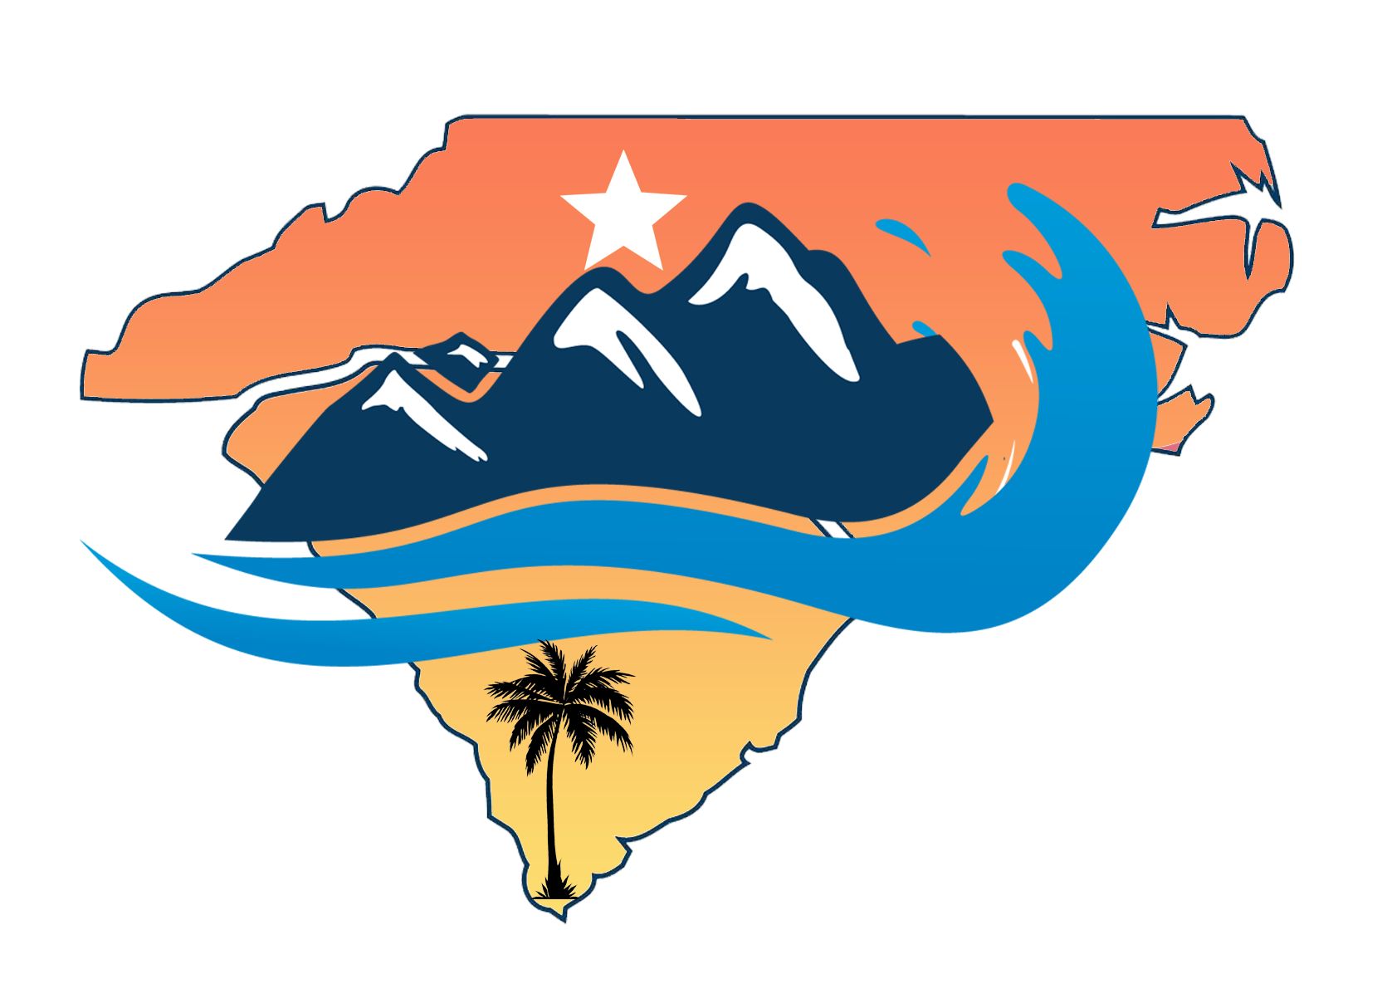
Carolina’s Chapter American Backflow Prevention Association (ABPA)
Speakers: Nissa Pauley
Kathy Riley

Slide 2
What is backflow and how will SB166/SL 2024-49 impact NC public water systems?
Talking Points
What are cross connections? Backflow? What causes it?
The risks cross connections introduce
How do we prevent backflow events?
How will SB166/SL 2024-49 impact NC public water systems?
Solutions
Q&A

Slide 3
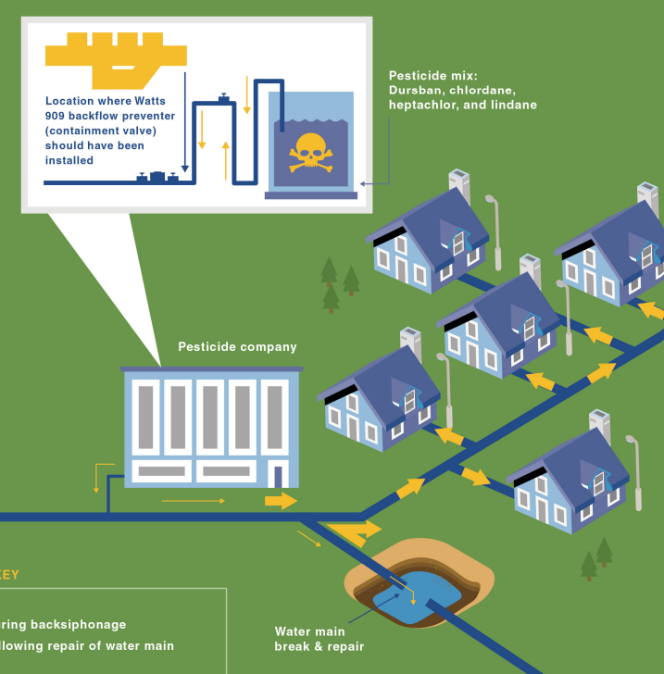
What Are Cross Connections?
A cross connection is the physical link or connection between drinking water (potable) and non-drinking water (non-potable).
Common Cross Connections:
Lawn Irrigation, Swimming pools
Chemical Stations
Fire sprinklers
Boilers, Chiller, any other HVAC Equipment
Pedicure bowls
Lab, Kitchen, Dental Equipment

Slide 4
Types of Cross Connections
Indirect Cross Connection
When there's a separation or gap between the clean and dirty water, but the possibility of them mixing may still exist under certain conditions
Direct Cross Connection
When clean and dirty water are directly connected without backflow protection in between them

Slide 5
What is Backflow?
Backflow: the reverse flow of water or other substance into a public water system from an unintended source.

Slide 6
What Causes Backflow?
Backflow events occur when water in a pipe flows in the opposite direction, which can cause contaminated water to mix with clean drinking water. Backflow occurs for one of two reasons:
Backsiphonage – water is siphoned backwards in the wrong direction.
Backpressure – water is pushed backwards in the wrong direction.

Slide 7
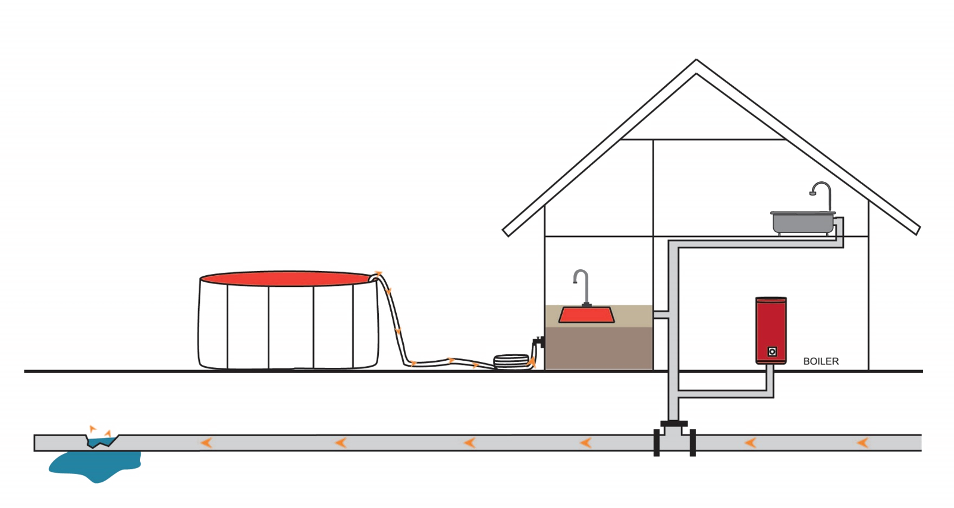
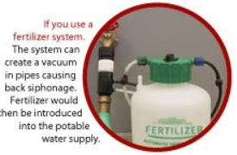
What is Backsiphonage?
Backsiphonage
Backflow caused by a drop in pressure, resulting in a vacuum-like effect which can pull contaminants into the drinking water supply

Slide 8
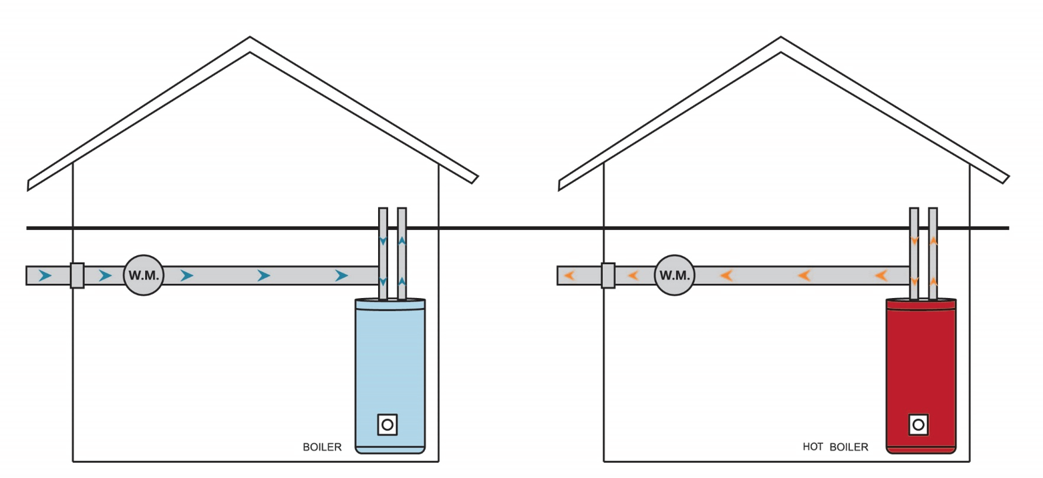
What is Backpressure?
Backpressure
Backflow caused when the customers plumbing side water pressure is HIGHER than the supply side. This usually occurs because of pumps, thermal expansion, or even lawn sprinkler systems on a sloped area.

Slide 9
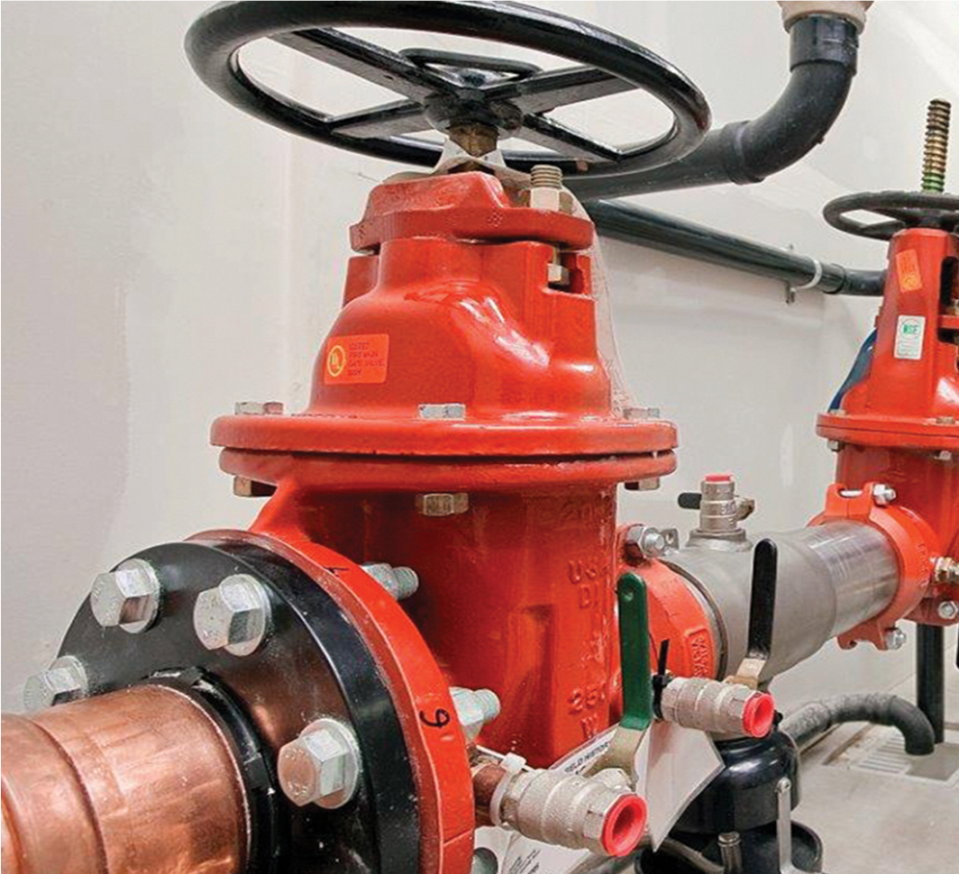
How Do We Prevent Backflow Events?
What is a Backflow Preventer?
A device or assembly to prevent water from flowing backward and contaminating the clean potable water supply.
Backflow preventers ensure that water only flows in one direction—from the clean potable water supply system to the outlets, such as faucets, irrigation systems, or other water-using devices.
Mechanical equipment like backflow preventers need regular maintenance and repair just like our vehicles to ensure they are working properly.

Slide 10
What is a Cross Connection Control Program?
Under the provisions of the safe drinking water act of 1974, the federal government has established through the EPA, national standards for safe drinking water. The states are responsible for the enforcement of these standards. Water purveyors are held responsible for this compliance.
GOALS: Protect, reduce, control, and comply with all State & Federal Requirements
Containment Program – this approach utilizes a minimum requirement and protects at the meter.
This approach protects the Water Purveyor but not the customers internal plumbing
Isolation Program – this approach protects the customers internal plumbing. This is mostly covered by the NC Plumbing Code

Slide 11
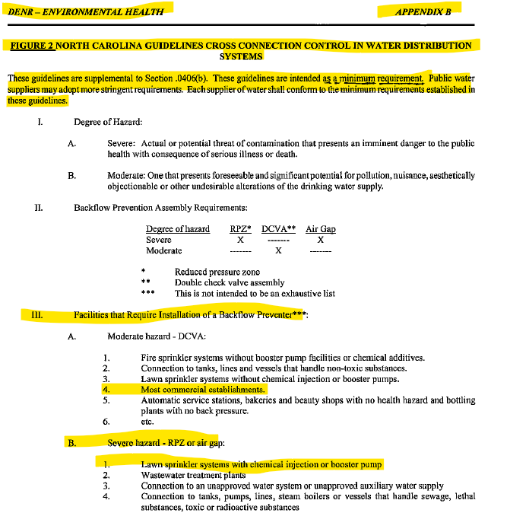
What did NCAC Title 15A say?
OLD NCAC Title 15A, Subchapter 18C, Sections .0300 and .0406, and Appendix B, Figure 2
KEY Verbiage, section .0709 “Prevention of Backflow and Back-siphonage”
KEY Verbiage, “Public water suppliers may adopt more stringent requirements.” This is because water purveyors are granted primacy in the Safe Drinking Water Act.
KEY Verbiage, under “Facilities that require the installation of a backflow preventer, Most commercial establishments.” This is a CONTAINMENT (at the meter) Program that 100% of water purveyors do.

Slide 12
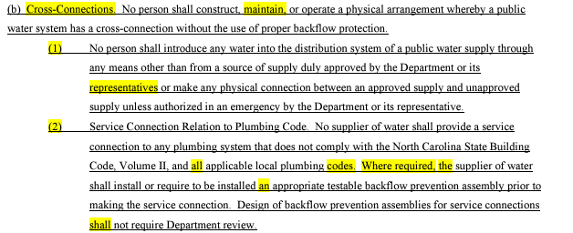
What does NCAC Title 15A say now?
CURRENT NCAC Title 15A, Subchapter 18C, Sections .0300 and .0406, and Appendix B, Figure 2
Revised Rules (Effective July 1, 2019)
[15A NCAC 18C.0406 (a)] states that no person shall create an unprotected cross connection to the public water system.
[15A NCAC 18C.0406 (a2)] “Where required, the supplier of water shall install or require to be installed an appropriate testable backflow prevention assembly prior to making the service connection.” NC Plumbing Code does not define a containment backflow preventer. Plumbing code doesn’t apply until 5 ft of the foundation wall and internal plumbing.

Slide 13
How will SB166/SL 2024-49 impact NC Public Water Systems?
The new Law makes Cross Connection Programs REACTIVE instead of Preventative.
This law directly impacts the water purveyors ability to perform their responsibilities in maintaining safe drinking water to each tap and undermines public health and safety. A water purveyor can monitor its source and provide treatment to ensure safe drinking water is provided, however we must also ensure that the water users do not affect water quality through unprotected cross connections. Without Backflow preventers, there’s a heightened risk of contamination, endangering the health of consumers.

Slide 14
Solution to §130A-330(a)
EDIT [15A NCAC 18C.0406 (a2)] to “Where required, the supplier of water shall install or require to be installed an appropriate testable backflow prevention assembly prior to making the service connection.”
EDIT [15A NCAC 18C] “Appendix B”, “High Hazard Service Connections” # 5 to "Fire sprinkler systems with booster pump facilities, or chemical additives, or FDC connection.”
ADD [15A NCAC 18C] “Appendix B”, “High Hazard Service Connections” list to include “All buildings connected to City water excluding single-family dwellings with no additional hazards.”

Slide 15
Solution to §130A-330(d)
EDIT 15A NCAC 18C.0406 to include a new subsection to say “All water suppliers/water purveyors shall at a minimum follow the AWWA M-14 Backflow Prevention and Cross Connection Control.”
EDIT 15A NCAC 18C.0406 to include a new subsection to say “All water suppliers/water purveyors shall at a minimum maintain a Containment Program as defined by the AWWA M-14.”
It currently says “where required”
ADD [15A NCAC 18C] “Appendix B”, “High Hazard Service Connections” to include “All buildings connected to City water excluding single-family dwellings with no additional hazards.”

Slide 16
NC Plumbing Code
608.1 General A potable water supply system shall be designed, installed and maintained in “such a manner so as to PREVENT contamination from nonpotable liquids, solids or gases being introduced into the potable water supply through cross connections or any other piping connections to the system.” 608.16.5 Connections to Lawn Irrigation Systems The potable water supply to lawn irrigation systems shall be protected against backflow by an AVB, a PVB or RP type backflow prevention assembly. Where chemicals are introduced into the system, the potable water supply shall be protected against backflow by a RP backflow prevention assembly. **SIDE NOTE: AVB, PVB, and RP type backflows are designated to HIGH hazard ** 301.7 Conflicts Where conflicts between this code and the conditions of the listing or the manufacturer's installation instructions occur, the provisions of this code apply. Exception: Where a code provision is less restrictive than the conditions of the listing of the equipment or appliance or the manufacturer's installation instructions, the conditions of the listing and manufacturer's installation instructions shall apply.

Slide 17
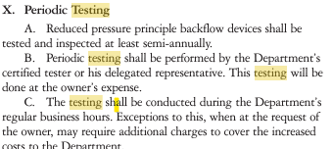
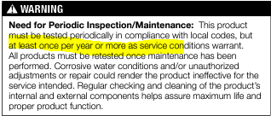
EPA & Manufacturer's installation, what do they say?
EPA says:
Manufacturer’s says:
Application Designed for installation on water lines to protect against both backsiphonage and backpressure of contaminated water into the potable water supply. Assembly shall provide protection where a potential health hazard exists.
Annual average irrigation failure rate is about 13-15% x 3 years = approx. 40%-45% failure rate. During the 3-year timeframe almost half of water customers would have compromised drinking water.

Slide 18
Solution to §130A-330(f)
EDIT 15A NCAC 18C.0406 to include a new subsection to say “All water suppliers/water purveyors shall at a minimum maintain an annual testing of backflow preventer assemblies in accordance with AWWA M-14.”
EDIT [15A NCAC 18C] “Appendix B”, “High Hazard Service Connections” to say “All Lawn sprinkler systems with chemical injection or booster pump.

Slide 19
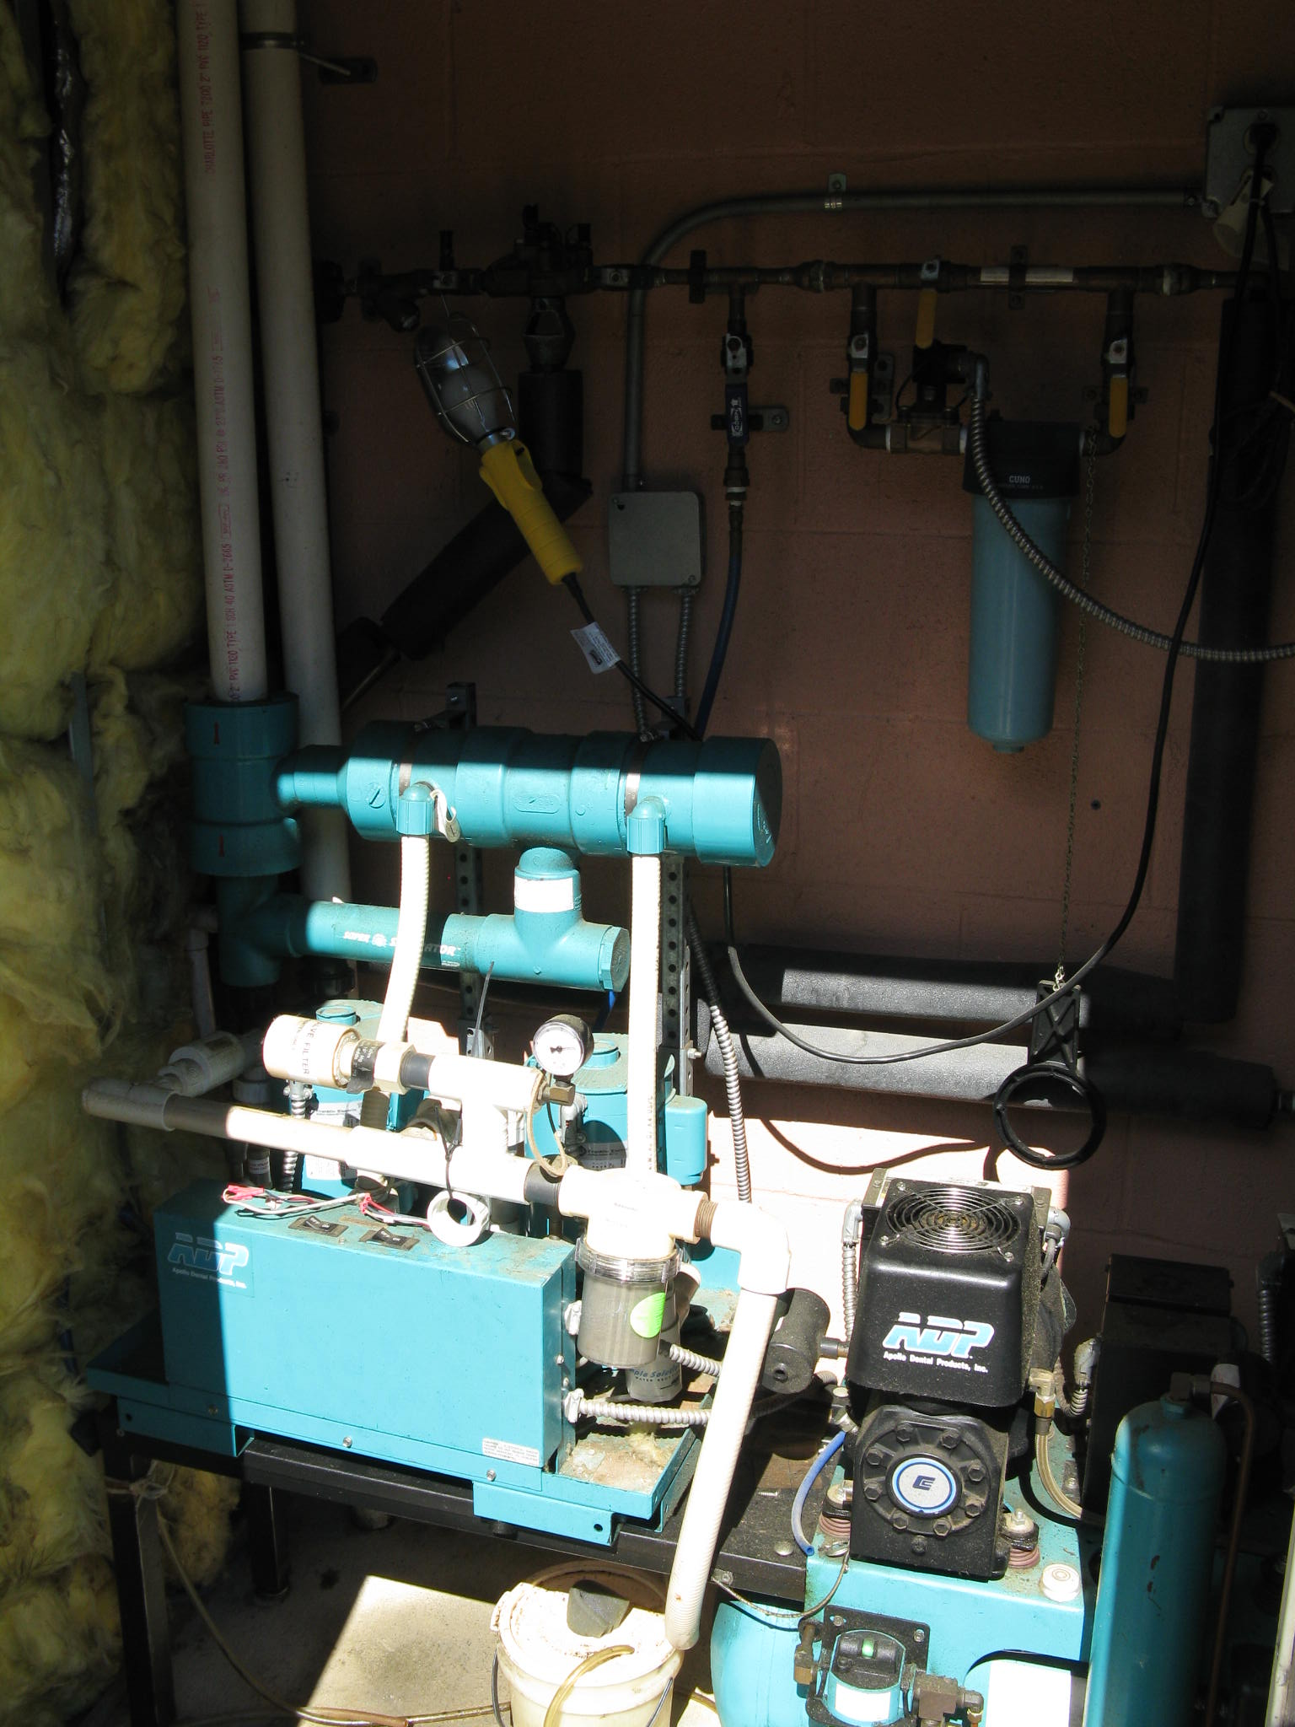
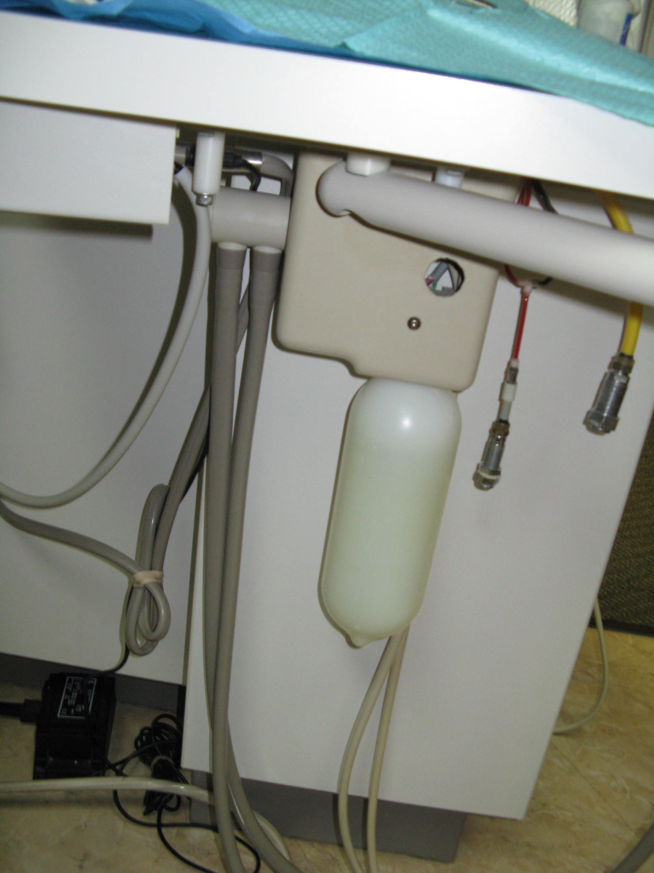
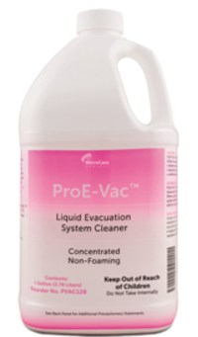
Real Life Examples
Example 1
Code official is called in because an existing dental office is complaining of pink water in their restrooms. The Code official finds that the vacuum system was installed after the certificate of occupancy was granted and the spittoons on the dental chairs are being recirculated through their internal plumbing and coming out in the sink in the restrooms. A backflow is required to isolate the dental spittoons from the drinking water in the suite. SB 166/SL 2024-49 would prohibit the water purveyor from making that water customer install a backflow. Legally, the water purveyor cannot perform the work because this is on private property.

Slide 20
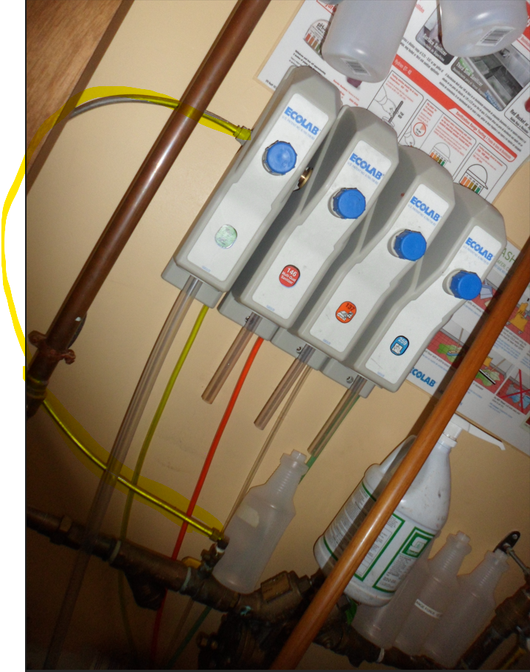
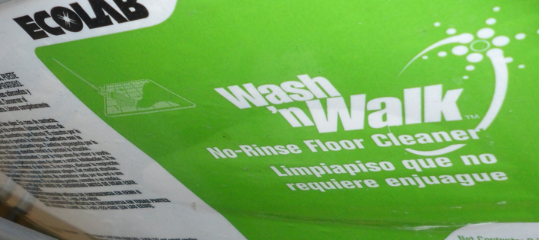
Real Life Examples
Example 2
Code official is called in to an existing pizza restaurant because they have purple soapy bubble water coming out of the drink dispensers. The Code official determines that after the certificate of occupancy was granted a janitorial company came in and hooked up their soap and degreaser unit to the internal water line causing the soap to backflow and ultimately coming out from the drink dispensers. SB 166/SL 2024-49 would prohibit the water purveyor from making that water customer install a backflow. Legally, the water purveyor cannot perform the work because this is on private property.

Slide 21
Real Life Examples
Example 3
Code official is called to a manufacturing plant because they have sweet water in the coffee maker. The Code official determines that after the certificate of occupancy was granted, years later they replaced an existing cooling system. The issue was that they replaced the old cooling system using internal employees who are not licensed to perform the work to save money. The employees tied in to the closest water line they could find. That water line was on the other side of the wall from the break room where the coffee maker was connected. This allowed antifreeze to enter the coffee maker. Antifreeze is odorless, toxic, and can affect the central nervous system.

Slide 22
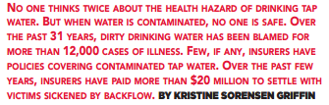
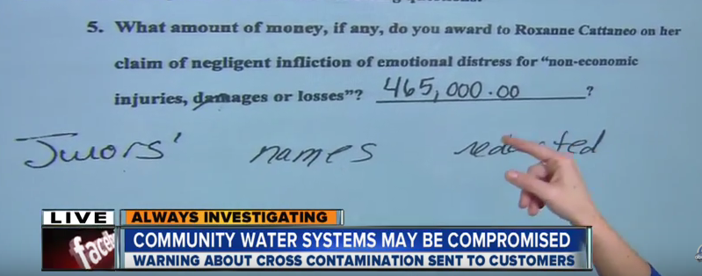
Financial Impact of Backflow Events
Labor Costs – 494 hours to remediate an incident
Millions and millions of dollars payouts from lawsuits

Slide 23
creation of a full-time Cross Connection Manager position within NCDEQ
This new NCDEQ position would oversee backflow prevention efforts, managing a State-wide Testers certification, and training programs, setting qualifications for instructors, and developing course curriculum to ensure compliance and safety across the State. I have drafted an outline for such requirements, please email jeffrey.talbott@deq.nc.gov for a DRAFT copy.
This position would be like the one in South Carolina under the Bureau of Water. This would serve as a state-mandated program designed to protect public health and would maintain that all ORC’s follow the same set of rules, requirements, etc.

Slide 24
Questions?
This Photo by Unknown Author is licensed under CC BY-NC
Email: Nissa.Pauley@durhamnc.gov
Kathy.Riley@charlottenc.gov

Slide 25
Supplemental Information
www.epa.gov/sites/default/files/2015-09/documents/epa816r03002_0.pdf
https://www.epa.gov/system/files/documents/2021-12/ds-toolbox-fact-sheets_ccc.pdf

Slide 26
Federal Law | State Law
SDWA of 1974 and the SDWA Amendments of 1986 states, individual states are responsible for enforcing the regulations and supervising public water systems (PWS). The water purveyor has the primary responsibility for preventing the introduction of pollutants or contaminants into the public drinking water distribution system, as outlined in the SDWA (United States Environmental Protection Agency [U.S. EPA] 816-F-04-030). To accomplish this, water purveyors must establish and implement a CCC program. | NCDEQ documents, Rules Governing Public Water Systems, which is comprised of the NCAC sections that are applicable to the management of PWSs. The sections of the NCAC that apply to CCC are provided in Title 15A, Subchapter 18C, Sections .0300 and .0406, and Appendix B, Figure 2 of the Rules Governing Public Water Systems provides CCC minimum requirements and guidance.
The SDWA enables states to apply for and receive primacy for the enforcement and management of CCC. The State of North Carolina (NC) has applied for and received primacy based on the condition that the NC standards are at least as stringent as the SDWA and that these standards are enforced. | The NCAC requires water purveyors to establish a CCC policy (T15A:18C.0307.c.5.A) and implement an operations and maintenance plan for backflow preventers (T15A:18C.0307.d.3)

Slide 27
Recent Backflow Incidents
Texas - September 2024
“Foaming agent” found in water supply was a result of a fire being put out” in Grand Prairie.
Approx. 60,000 people were impacted

Slide 28
Recent Backflow Incidents
Louisiana - August 2024
The Louisiana Department of Health issued a 'do not use' water advisory for Madison Parish residents
The advisory was prompted by backflow of herbicide “Paraquat” into the water supply while a farmer was filling a tank. This is a toxic chemical that is widely used.

Slide 29
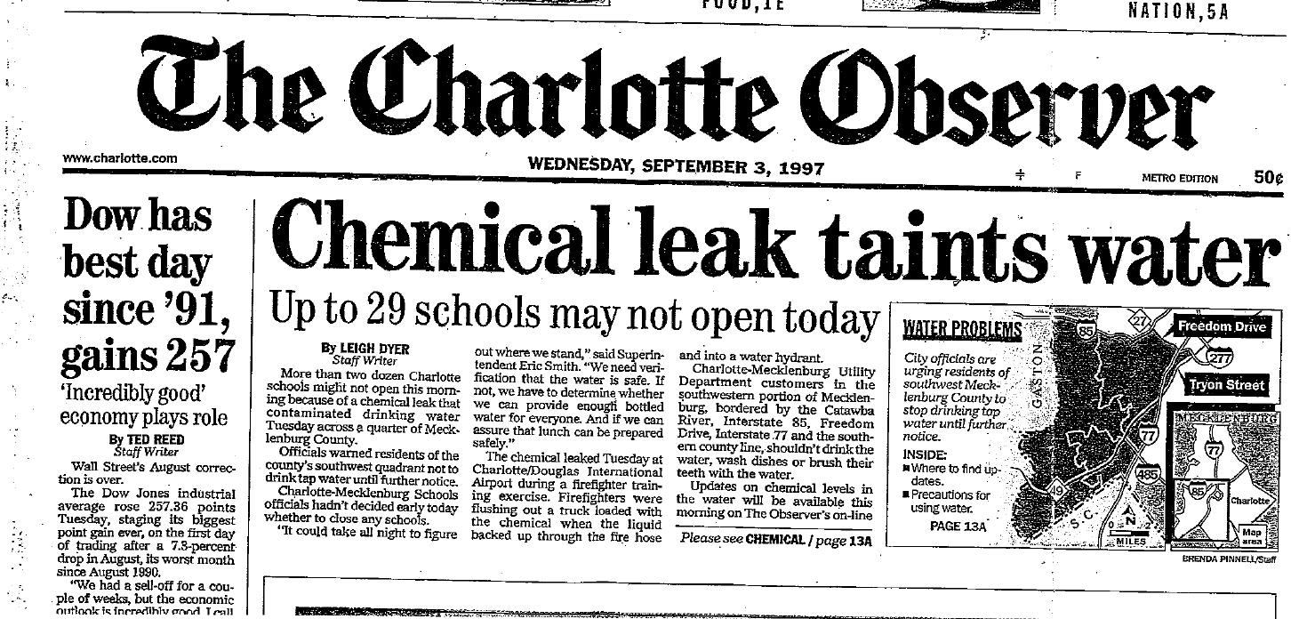
Backflow Incidents
North Carolina – September 1997
A chemical leak contaminated the drinking water in Mecklenburg County, North Carolina
The incident occurred during a firefighting drill at Charlotte/Douglas International Airport, where a truck accidentally flushed a chemical into the water system
29 schools in the affected area faced closures due to the contamination. Residents were advised to avoid drinking the water until further notice.
Over $10 million dollars spent to fix the contamination
**For additional backflow incidents, please go to https://www.durhamnc.gov/3089/Helpful-Links **

